Slide 1
Writing to Learn: Heat
Jeff Goodman
Department of Curriculum and Instruction
Appalachian State University
goodmanjm@appstate.edu
Notes:
Note: Writing to Learn techniques are in green throughout.

Slide 2
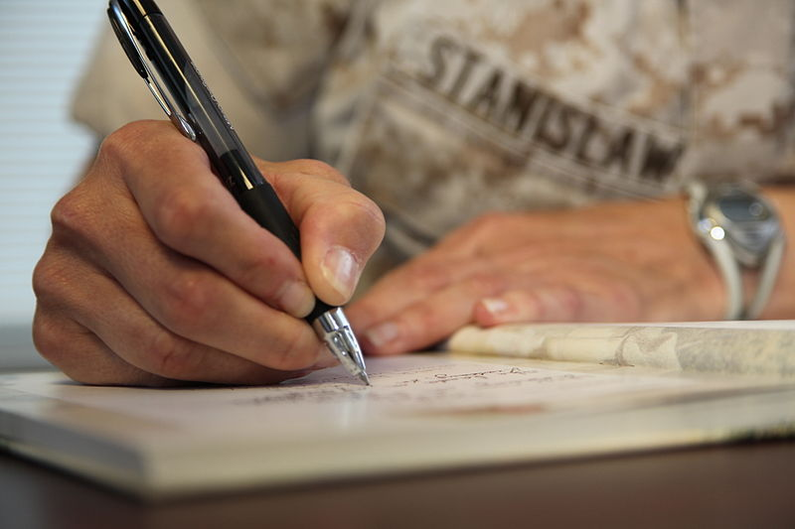
Journal writing
Write for one minute about a time you were especially hot or cold.

Slide 3
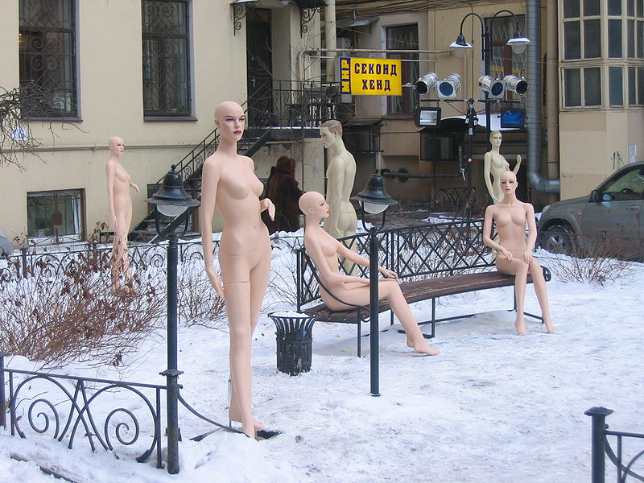
Personal definitions
The Dummy family comes to you and asks you,
“What is heat?” Explain in your own terms.

Slide 4
What will happen? Why?
Talk then write

Slide 5
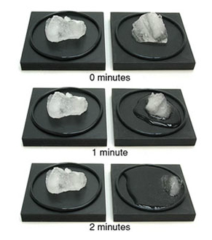
Talk then write
What happened? Why?

Slide 6
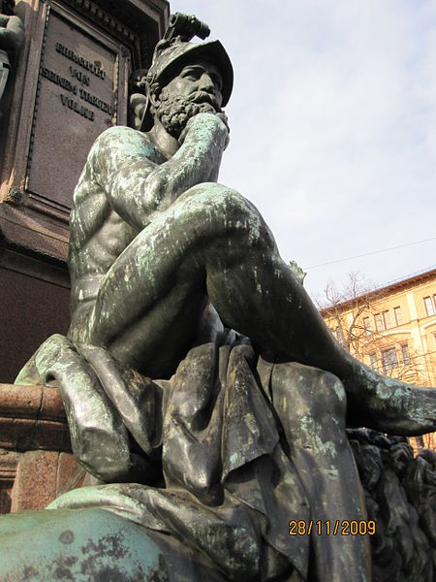
Sentence synthesis
Write one sentence that describes the key idea from this experience.
Notes:
http://commons.wikimedia.org/wiki/File:Maxmonument.jpg

Slide 7
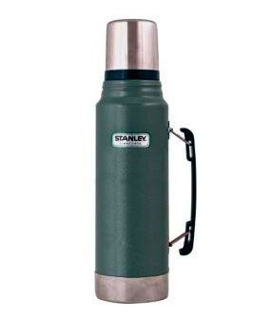
Think-write-pair-share
Jeff: “Aunt Vivi, you’ve lived a long time. What’s the most amazing invention of all time?”
Aunt Vivi: “The thermos!”
Jeff: “The thermos?”
Aunt Vivi: “Yes! It keeps hot
things hot and cold things cold.”
Jeff: “So what?”

Slide 8
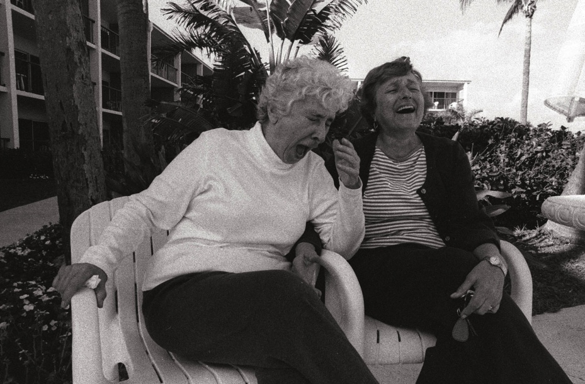
Think-write-pair-share
Aunt Vivi:
“Ha! Mr. Smartypants, HOW does it know the difference!?”

Slide 9
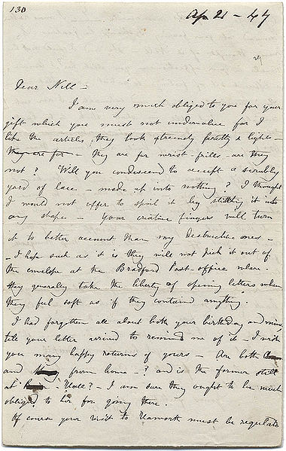
Letter to a friend
Write a letter to a friend telling what we did with the ice cubes and explaining the effect.
Notes:
Gunel, M., Hand, B., & McDermott, M. (2009). Writing for different audiences: Effects on high-school students' conceptual understanding of biology. Learning & Instruction, 19(4), 354-367. doi:10.1016/j.learninstruc.2008.07.001
Abstract: Writing-to-learn activities in science classrooms can have an impact on student learning. This study sought to examine if the audience for which students write explanations of biology concepts affects their understanding of these concepts. One hundred eighteen Year 9/10 biology students from four classes participated in the study. There were four different audiences: teacher, younger students, peers, and parents. Students'' writing for peers or younger students performed significantly better on conceptual questions than students writing for the teacher or the parents. [Copyright &y& Elsevier]

Slide 10
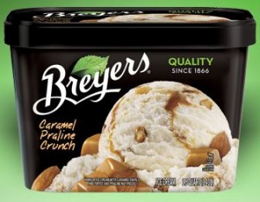
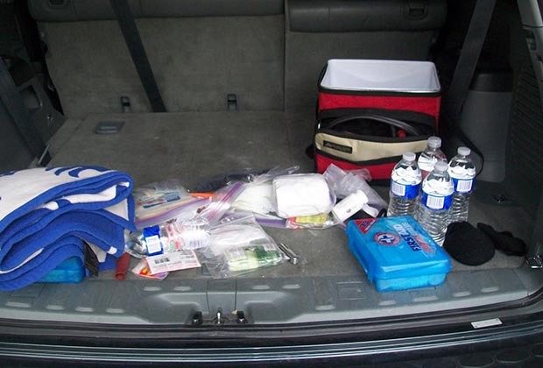
Writing with images
My mom and dad once had an argument as they were putting groceries into the car trunk.
It was a hot day, and my mom wrapped up the groceries (including some ice cream) in a blanket that was in the trunk.
My dad exclaimed, “Charlotte, you’re going to melt the ice cream if you do that!”
Mom responded, “No, dummy! I was trying to keep the ice cream from melting!”
Who’s right? Why? Explain using images from magazines.

Slide 11
Explain your process
Celsius (C) and Fahrenheit (F) are two different temperature scales. Water freezes a 0 ⁰ C and 32 ⁰ F. Water boils at 100 ⁰ C and 212 ⁰ F. Which is most likely the equivalent of 25 ⁰ C?
110 F
77 F
57 F
-7 F

Slide 12
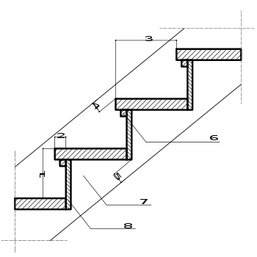
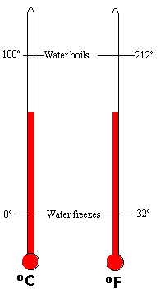
TALLER STEPS
SHORTER STEPS
180 STEPS
100 STEPS

Slide 13
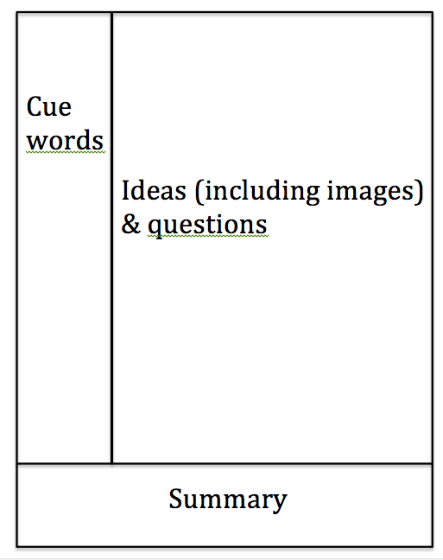
Cornell Notes
Notes:
http://lsc.cornell.edu/Sidebars/Study_Skills_Resources/cornellsystem.pdf

Slide 14
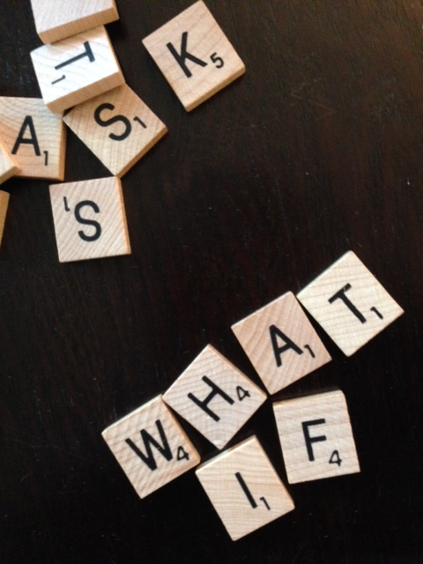
Students create test questions
Notes:
http://commons.wikimedia.org/wiki/File:What_if_I_ask_for_help.JPG

